Slide 1

Filename: HW#_StuID.zip
  Ex) HW1_Q12345678.zip
Due: Next Wed. 23:59:59
Introduction to Computers II

Slide 2



Slide 3

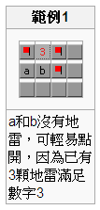
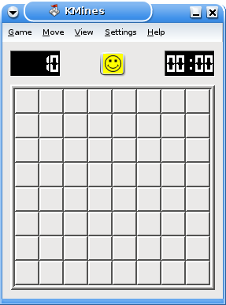
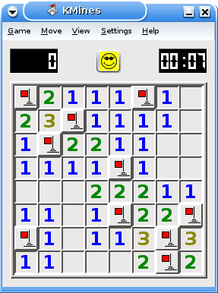

Slide 4

Show the chessboard
Input X,Y
Start
No
Is X,Y legal?
Input length, mine_number
Yes
Press the X,Y
Boom!
lose
no
Is value legal?
Not Boom!
yes
Recursively check neighbors
No
Some mines nearby
Init, and Set mine information
Yes
Some mines not been traced
Show number of mines
Yes
win
No

Slide 5
Show the chessboard
Input X,Y
Start
No
Is X,Y legal?
Input length, mine_number
Yes
Press the X,Y
Boom!
lose
no
Is value legal?
Not Boom!
yes
Recursively check neighbors
No
Some mines nearby
Init, and Set mine information
Yes
Some mines not been traced
Show number of mines
Yes
win
No

Slide 6
mine_info[x][y]
-2: wall
-1: mine
0: there is no mine around
>0: number of mines around (x,y)
map_press[x][y]
0: unstepped,
1: stepped
Wall | Wall | Wall | Wall | Wall | Wall | Wall
Wall | (1,1) |  |  |  |  | Wall
Wall |  |  |  |  |  | Wall
Wall |  |  |  |  |  | Wall
Wall |  |  |  |  |  | Wall
Wall |  |  |  |  |  | Wall
Wall | Wall | Wall | Wall | Wall | Wall | Wall
MineBoard

Slide 7

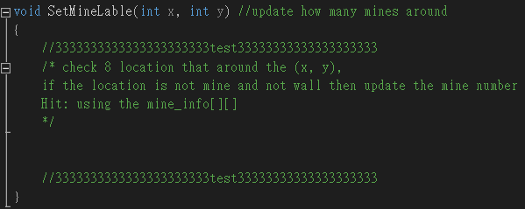
 | 1 | 1 | 1
 | 1 | 雷 | 1
 | 1 | 1 | 1
1 | 2 | 1 | 1
雷 | 2 | 雷 | 1
1 | 2 | 1 | 1

Slide 8
Show the chessboard
Input X,Y
Start
No
Is X,Y legal?
Input length, mine_number
Yes
Press the X,Y
Boom!
lose
no
Is value legal?
Not Boom!
yes
Recursively check neighbors
No
Some mines nearby
Init, and Set mine information
Yes
Some mines not been traced
Show number of mines
Yes
win
No

Slide 9
Show the chessboard
Input X,Y
Start
No
Is X,Y legal?
Input length, mine_number
Yes
Press the X,Y
Boom!
lose
no
Is value legal?
Not Boom!
yes
Recursively check neighbors
No
Some mines nearby
Init, and Set mine information
Yes
Some mines not been traced
Show number of mines
Yes
win
No

Slide 10
Show the chessboard
Input X,Y
Start
No
Is X,Y legal?
Input length, mine_number
Yes
Press the X,Y
Boom!
lose
no
Is value legal?
Not Boom!
yes
Recursively check neighbors
No
Some mines nearby
Init, and Set mine information
Yes
Some mines not been traced
Show number of mines
Yes
win
No

Slide 11

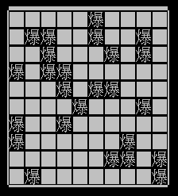
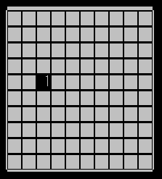
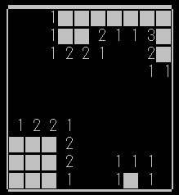
We have to consider 3 cases.
  Boom!
  No explosion, but there are some bombs next to the position.
  No explosion, and no bomb nearby.

Slide 12

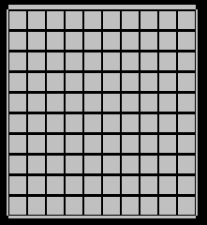
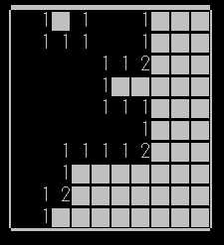
Press() function
Recursively check the neighbors

Slide 13
We have to use “Recursion”.
1 | 2 | 1 | 1
雷 | 2 | 雷 | 1
1 | 2 | 1 | 1 | 1 | 1
1 | 1 |  | ★ | 1 | 雷
雷 | 2 | 1 | 2 | 3 | 3
1 | 2 | 雷 | 2 | 雷 | 雷
1 | 2 | 1 | 1
雷 | 2 | 雷 | 1
1 | 2 | 1 | 1 | 1 | 1
1 | 1 | ★ |  | 1 | 雷
雷 | 2 | 1 | 2 | 3 | 3
1 | 2 | 雷 | 2 | 雷 | 雷
1 | 2 | 1 | 1
雷 | 2 | 雷 | 1
1 | 2 | 1 | 1 | 1 | 1
1 | 1 |  | ★ | 1 | 雷
雷 | 2 | 1 | 2 | 3 | 3
1 | 2 | 雷 | 2 | 雷 | 雷
1 | 2 | 1 | 1
雷 | 2 | 雷 | 1
1 | 2 | 1 | 1 | 1 | 1
1 | 1 |  |  | 1 | 雷
雷 | 2 | 1 | 2 | 3 | 3
1 | 2 | 雷 | 2 | 雷 | 雷
1 | 2 | 1 | 1
雷 | 2 | 雷 | 1
1 | 2 | 1 | 1 | 1 | 1
1 | 1 |  | ★ | 1 | 雷
雷 | 2 | 1 | 2 | 3 | 3
1 | 2 | 雷 | 2 | 雷 | 雷
1 | 2 | 1 | 1
雷 | 2 | 雷 | 1
1 | 2 | 1 | 1 | 1 | 1
1 | 1 | ★ |  | 1 | 雷
雷 | 2 | 1 | 2 | 3 | 3
1 | 2 | 雷 | 2 | 雷 | 雷
1 | 2 | 1 | 1
雷 | 2 | 雷 | 1
1 | 2 | 1 | 1 | 1 | 1
1 | 1 |  | ★ | 1 | 雷
雷 | 2 | 1 | 2 | 3 | 3
1 | 2 | 雷 | 2 | 雷 | 雷
1 | 2 | 1 | 1
雷 | 2 | 雷 | 1
1 | 2 | 1 | 1 | 1 | 1
1 | 1 |  | ★ | 1 | 雷
雷 | 2 | 1 | 2 | 3 | 3
1 | 2 | 雷 | 2 | 雷 | 雷
★=(x, y)的位置

Slide 14
Show the chessboard
Input X,Y
Start
No
Is X,Y legal?
Input length, mine_number
Yes
Press the X,Y
Boom!
lose
no
Is value legal?
Not Boom!
yes
Recursively check neighbors
No
Some mines nearby
Init, and Set mine information
Yes
Some mines not been traced
Show number of mines
Yes
win
No

Slide 15

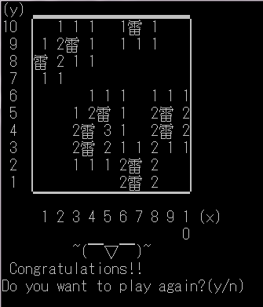
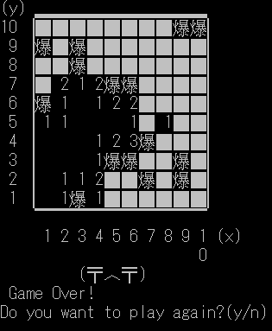

Slide 16

Ask the user to input height and width of the map, and also the number of mines in the map at the beginning.
The number of mines should not exceed the number of grids in the map.
Check if the user want to play again after win/lose.
Make sure the program can function properly with occasional invalid inputs.
Introduction to Computers II

